Slide 1
INTRODUCTION TO GUI DEVELOPMENT
Front-end components: HTML structure, CSS styling, JavaScript functionality and integration with Flask for backend functionality.
Notes:
After displaying this slide I will open the web application and talk about html and css styling, I will also show the code just as background when I present the javascrip functionalities

Slide 2
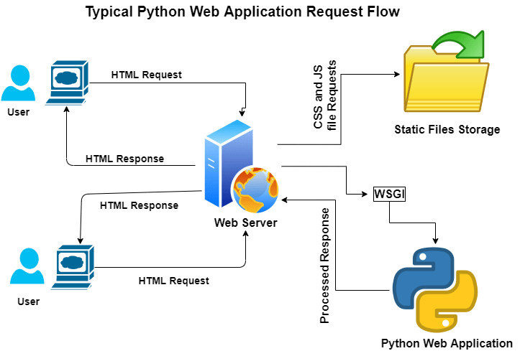
Integration with Flask
Flask Integration:
Renders the main HTML page.
Handles image processing requests and returns OCR results.
Manages different views.
Notes:
Show also the powershell post request of flask

Slide 3
Results and Challenges
User Interaction: Users can upload images or capture photos easily.
Responsive Design: Consistent experience across devices.
Challenges:
Implementing camera access and mirroring.
Ensuring full responsiveness.
Integrating client-side and server-side programming.
Notes:
And after this slide I will show the usage of our web application

